Slide 1


Literacy Strategies
There is no such thing as a child who hates to read; there are only children who have not found the right book.”
― Frank Serafini

Slide 2
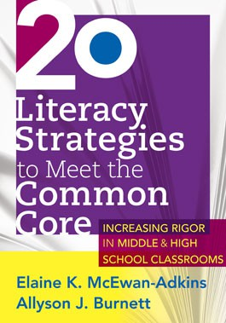
Literacy Strategies Resource
Middle School and High School have implemented these strategies.
PLC Focus for 2013-2014 for FSHS and 2014-2015 for FSMS.
Online Support:
www.solution-tree.com

Slide 3
Literacy Strategies Resources:
http://www.solution-tree.com/free-resources/commoncore/20lsmcc?___SID=U

Slide 4
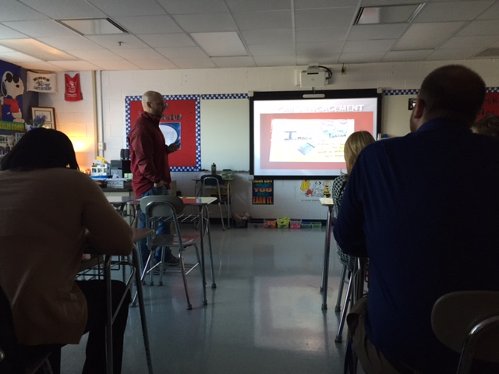
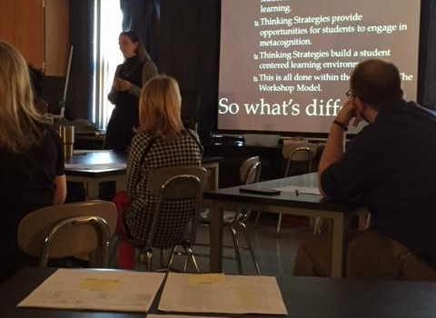
Literacy Strategy Resources
http://www.solution-tree.com/free-resources/commoncore/20lsmcc?___SID=U

Slide 5
5 Literacy Strands
Reading
Writing
Thinking
Speaking
Listening

Slide 6
Keys to Comprehension
Using Schema (Background Knowledge)
Creating Mental Images
Questioning
Inferring
Determining Importance (Summarizing)
Synthesizing
Monitoring for Meaning

Slide 7
Schema- Background Knowledge
Proficient readers spontaneously and purposefully recall their relevant background knowledge (schema) before, during, and after they read.
Proficient readers assimilate information from text and other learning experiences into their background knowledge and make changes in it to accommodate new information.
Proficient readers adapt their background knowledge as they read, talk, and learn, deleting inaccurate information, adding to existing schema, and connecting to other related knowledge, opinions, and ideas.

Slide 8
Schema- Background Knowledge
Text-to-self connections: applying personal life experience to what they read.
Text-to-text connections: applying knowledge about other texts (movies, videos, television programs) to what they read.
Text-to-world connections: applying their general world knowledge to what they read.
Proficient readers ACTIVATE (recall relevant background knowledge)
and BUILD (create background knowledge on a given topic, author, text
structure, etc.) background knowledge.
“THAT REMINDS ME OF…”
“I REMEMBER…”
“I HAVE A CONNECTION…”

Slide 9
Mental Images
Proficient readers adapt their images as they continue to read. Images are revised to incorporate new information revealed through the text and new interpretations as they are developed by the reader.
Proficient readers understand and articulate how creating images enhances their comprehension.
Proficient readers change and modify their images in response to images that other readers share.
“WHAT DO YOU HEAR, FEEL, TASTE, SMELL, PICTURE?”
“WHAT DO SEE IN YOUR MIND?”

Slide 10
Questioning- Key Concepts
When an answer is needed, proficient readers determine whether it can be answered by the text, whether they will need to infer the answer from the text and their background knowledge, or whether they will need to seek the answer elsewhere.
Proficient readers understand how the process of questioning is used in other areas of their lives.
Proficient readers understand how asking questions deepens their comprehension.
Proficient readers are aware that as they hear others' questions, new ones are inspired in their own minds.
“I wonder…”
“Why…?”
“What…?”

Slide 11
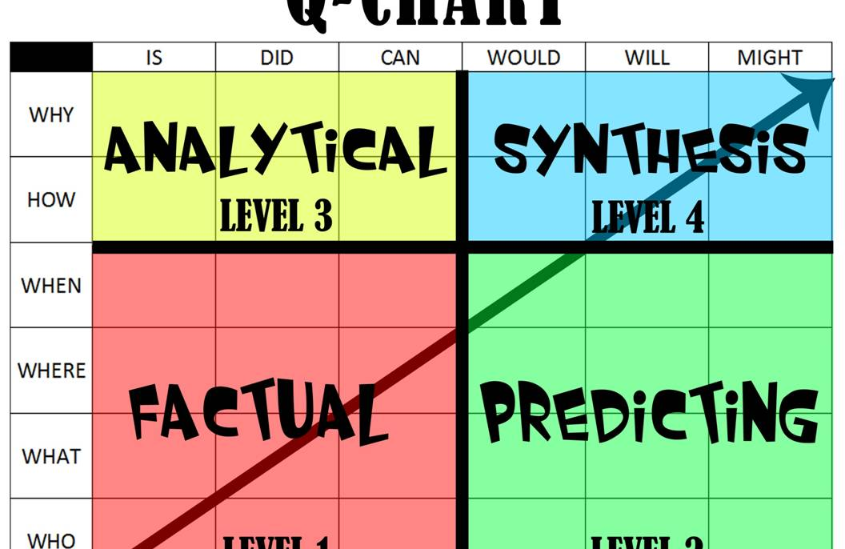
Questioning Chart

Slide 12
Inferring- Key Concepts
When they infer, proficient readers:
  draw conclusions;
  make reasonable predictions;
  create dynamic interpretations;
  use their background knowledge and explicitly stated information from the text to answer questions they have as they read;
  make connections between their conclusions and other beliefs or knowledge;
  make critical or analytical judgments about what they read.
I think that…
I predict…
My guess is…
My conclusion here is…

Slide 13
Possible “Fix-Ups”
Go back and reread. Often, that’s enough.
Read ahead to clarify meaning.
Identify what it isn’t understand: word, sentence, concept.
If it is a word, read beyond it and see if its meaning is clarified later in the text; or think about the content so far and predict what word might make sense. If those approaches don’t work, ask someone what it means or look it up in a dictionary.
If it is a sentence in a picture book, look at the pictures and think about what has happened so far; then reread and read ahead. If still confused, talk with a friend, parent, or teacher about it.
If it is a concept, try to summarize the story up to the confusing spot. See if that clears up the confusion. It may be necessary to build more background knowledge. That means going to an encyclopedia, checking out the Internet, having a conversation with someone who knows about the topic or researching in the library.

Slide 14
How do we present information in a way that suits MEMORY?
Brain Research Implications:
C
hunking: grouping bits of information into larger chunks
P
atterns: placing information in context
R
elevance: looking for personal connections to the information

Slide 15
How do we present information in a way that suits MEMORY?
Compare and Contrast a Visual Organizer with a Traditional Outline.
I.
A.
B.
1.
2.
II.

Slide 16
Modeling
Watch me as I do it- Mimicry
Let’s Do It Together- Collaboration
Let’s Talk and Write About It
“I DO”
“WE DO”
“YOU DO”

