Slide 1
Identify-Analyze-Summarize
February- 2015

Slide 2
THE GIST
You will notice the increase rigor of this strategy….
Scaffolds the steps of summarizing and provides another way to rehearse this important reading-thinking-writing process.
Students are able to rehearse two of the most challenging academic tasks:
Figuring out what the central idea or theme of a text is
Writing a one-sentence summary explaining that idea

Slide 3
A THOUGHT TO PONDER...
“If you can’t put the information into your own words, you aren’t ready to write about.”
“To learn how to paraphrase what you want to write, try to explain it to someone else without referring to your source.”

Slide 4
Days Gone By….
Main idea instruction consisted of little more than reading short selections and circling the best title for the selection.
This strategy applies reading-thinking-writing

Slide 5
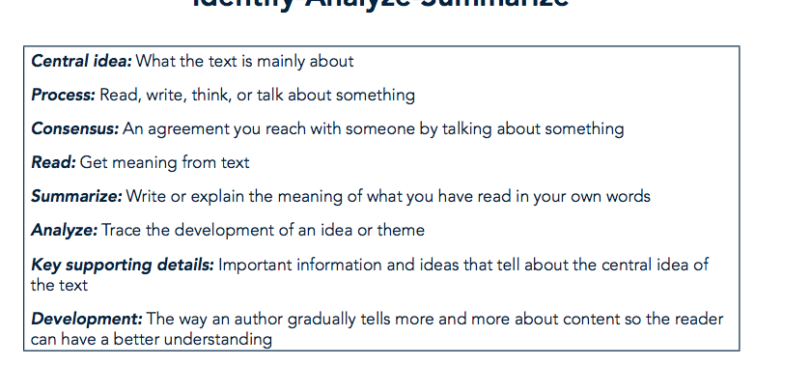
Student Friendly Definitions

Slide 6
Organizer Template….
Notice the multiple steps for this organizer…
  Central Theme
  Support of Central Theme
  Summary
  These are all components of each chunk using this strategy.

Slide 7
Gradual Release….
CHUNK 1- Teacher Example
CHUNK 2- Guided Practice with peers
CHUNK 3- Independent Practice

