Slide 1
Literacy Strategy 7- Snapshot Summary
February 2015

Slide 2
The Gist
Use the metaphor of taking a snapshot to summarize and preserve a memory, students are asked to read a text and create a “snapshot summary.”

Slide 3
The Purpose
This strategy is a model used to demonstrate how to scaffold students processing skills.
This organizer helps to improve students’ recall of what they have read compared to simply being given a reading assignment with a list of questions to answer.

Slide 4
A Quality Summary…
Definition- To succinctly state the meaning of what you have read in your own words.
Goal- In content classrooms it is that students will be able to write a summary about what they have read.
Characteristics- short, do not contain unimportant information, they only tell what is most important

Slide 5
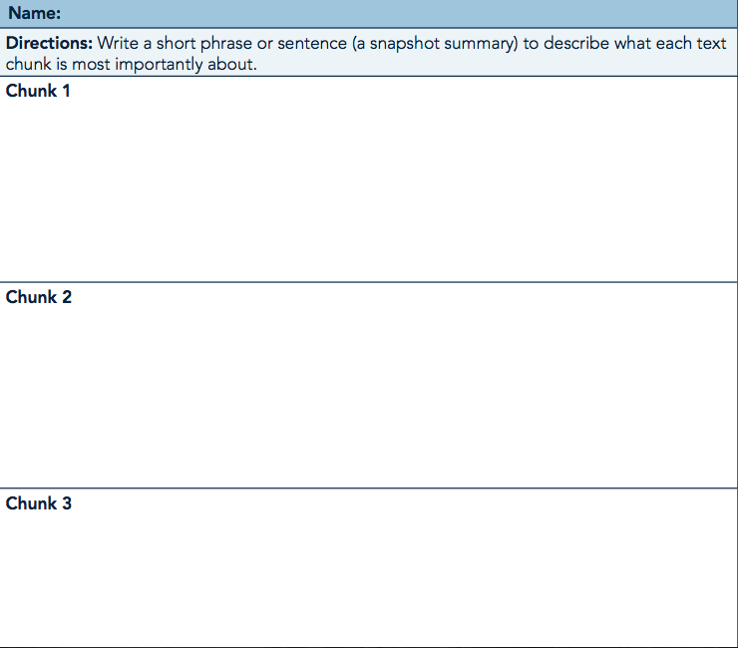
Organizer Template

Slide 6
Student Friendly Directions

Slide 7
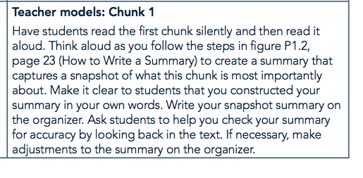
Gradual Release…

Slide 8
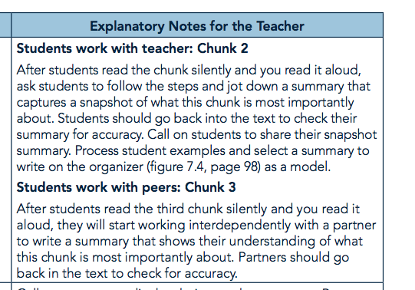
Gradual Release…

